Slide 1

Fatal Police Shootings in the United States from 2015-2022 Team 7 Midterm Exploratory Data Analysis Alex Khater, Rajeev Koneru, Cora Martin

Slide 2

Data Set Information
In response to a severe lack of reporting within government sources, The Washington Post compiled a database of every fatal police shooting in the United States from 2015-2022. We are interested in exploring this data, specifically as it relates to differences between U.S. states and regions.
After accounting for null values, the data set we are working with has 6,574 observations. Below we have provided a sample row of the data:
Name | Date | Manner of Death | Armed | Age | Gender
Tim Elliot | 10/04/2022 | Shot | Gun | 53 | M
Race | City | State | Signs of Mental Illness | Threat Level | Flee
A | Shelton | WA | 1 | TRUE | Not fleeing
Body Camera | Longitude | Latitude | Is Geocoding Exact
FALSE | -123 | 47.2 | TRUE

Slide 3
RAJEEV START HERE

Slide 4
SMART Research Question
Within our data set of 6,574 observations of police shootings from 2015 to 2022 in the United States, is there a significant difference between the U.S. States’ proportions of fatal police shootings that are captured by body cameras?
S
Variables that matter for our question: US state where the shooting took place and whether the police body camera was on or off
M
Statistical analysis used to measure differences between many proportions (this will require data reshaping)
A
The amount of data is manageable with only 6,574 observations spanning over a seven-year period.
R
We may apply this research to state policy on body cameras during police work.
T
With three people working on this research, a couple of weeks are required to perform the data analysis.

Slide 5
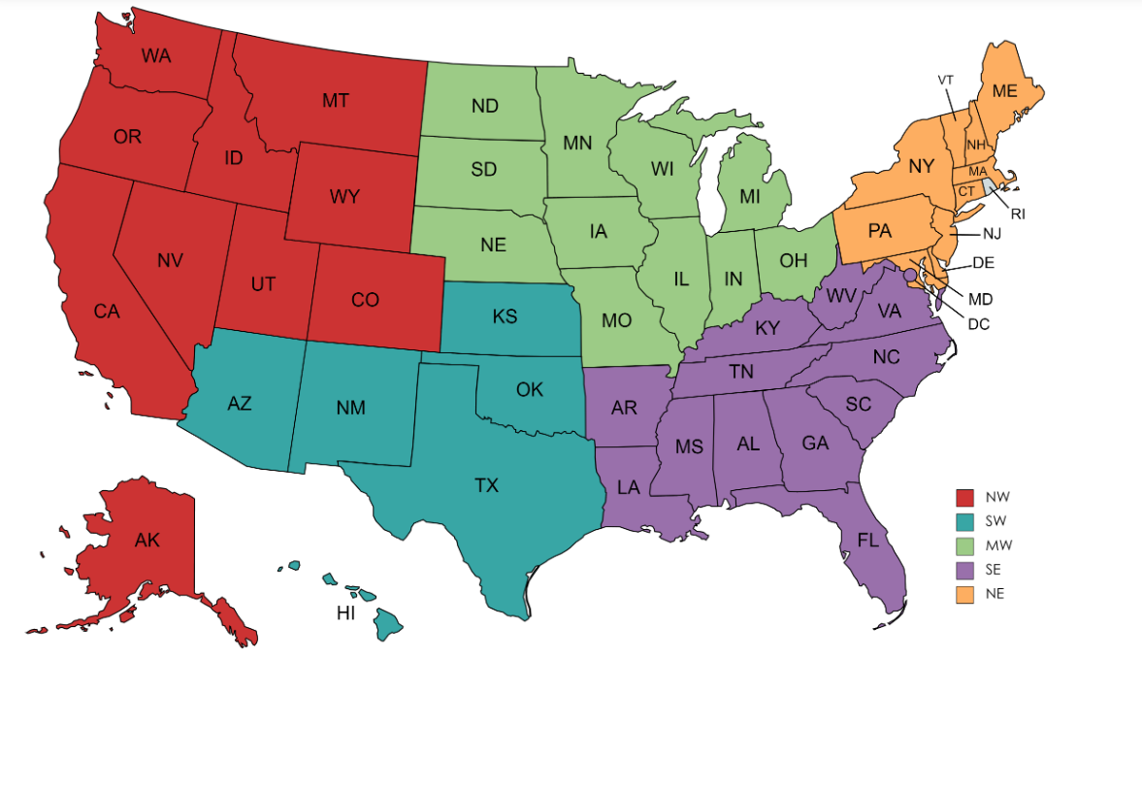
Reshaping Our Data for the SMART Q
Group Data and Variables by State to foster comparisons at the State level
Separated the Data into Regions for Graphical Display Purposes

Slide 6
A Key New Variable: stbcp
stbcp: the proportion of an officer’s body camera being on during a fatal shooting
Mean of stbcp= 0.144
This will allow us to compare states by proportion…

Slide 7
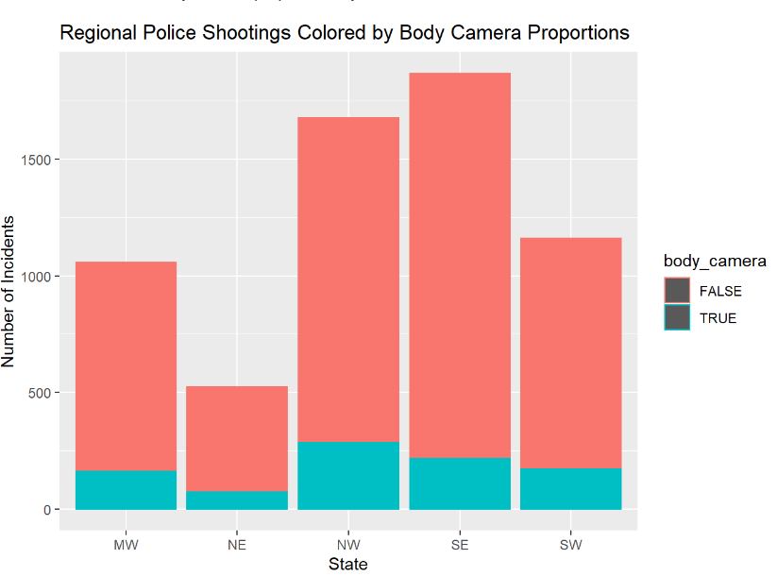
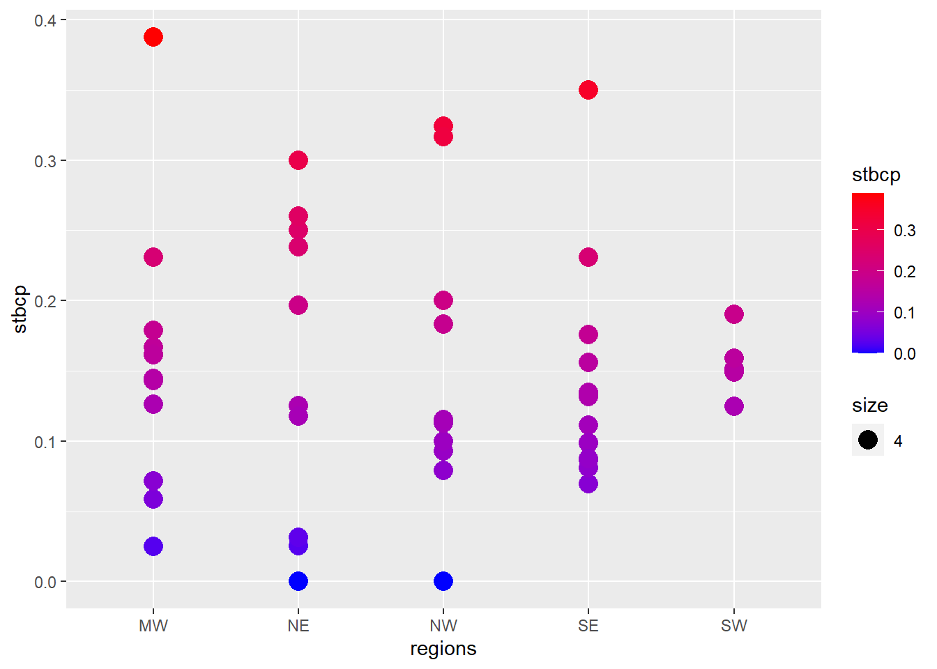
Body Cameras By Regions

Slide 8

How Do We Measure A Significant Difference ?
Introducing: The Chi-Square Test
The Chi-Square Test (X^2) is a test for comparing distributions of categorical variables
It works by comparing counts of each category and seeing if they differ from a preconceived “expected amount”
The Null Hypothesis is always: “The proportions are all equal” and The Alternative Hypothesis is always “The proportions are not all equal”
This test outputs a p-value (just like Z and T tests)

Slide 9
What are the conditions for using a Chi-Sq Test ?
Conditions:
Both Variables are Categorical:
a. We can check this off because “state” and “body camera” are
2. Independent Observations:
a. We know our observations to be independent as none of them meaningfully increase the probability of others (within the scope of this project)
3. Mutually Exclusive Categories:
a. Satisfied
4. Expected value of cells should be 5 or greater in at least 80% of cells.
a. Let’s talk about that…
Source: https://www.statology.org/chi-square-test-assumptions/

Slide 10
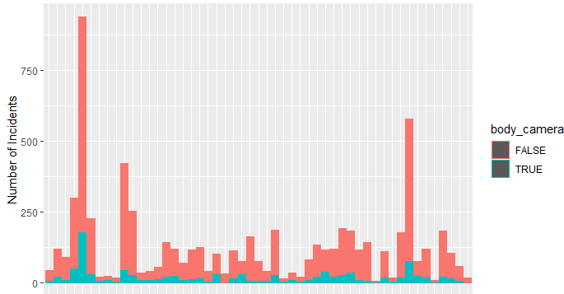
Conditions for using a Chi-Sq Test 2
We can see in our previous graphs that all our states have at least n=33 observations and the mean of stbcp is 0.144. So for the smallest number of state observations (AK)
0.144*33= 4.752
The rest of the states all have larger observation numbers (next smallest is 39), so we can say that 80% of our data easily passes this threshold of 5
Source: https://www.statology.org/chi-square-test-assumptions/

Slide 11
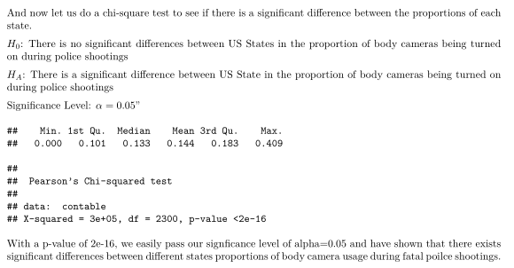
The Results
Source: https://www.statology.org/chi-square-test-assumptions/

Slide 12
Thank You For Listening
Questions ?

